Slide 1

MARKET PLACE FOR NORTHWEST Buy and sell here
Section-03
Team-03
Dr. CHANDRA MOULI KOTTETI – Client/mentor
SAJIDA MOHAMMAD – Backend developer
USHA PATI – Tester/QA
HARIKIRAN ALURI – Team lead/Front-end developer
KIRAN KUMAR GUNDAPUNENI – Backend developer
Presented By Sajida

Slide 2
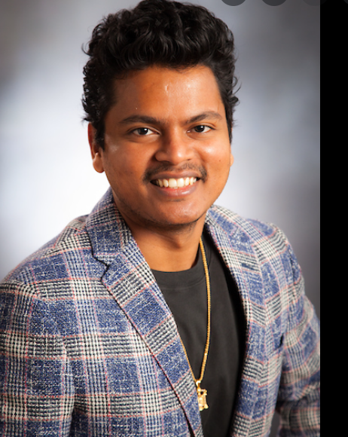
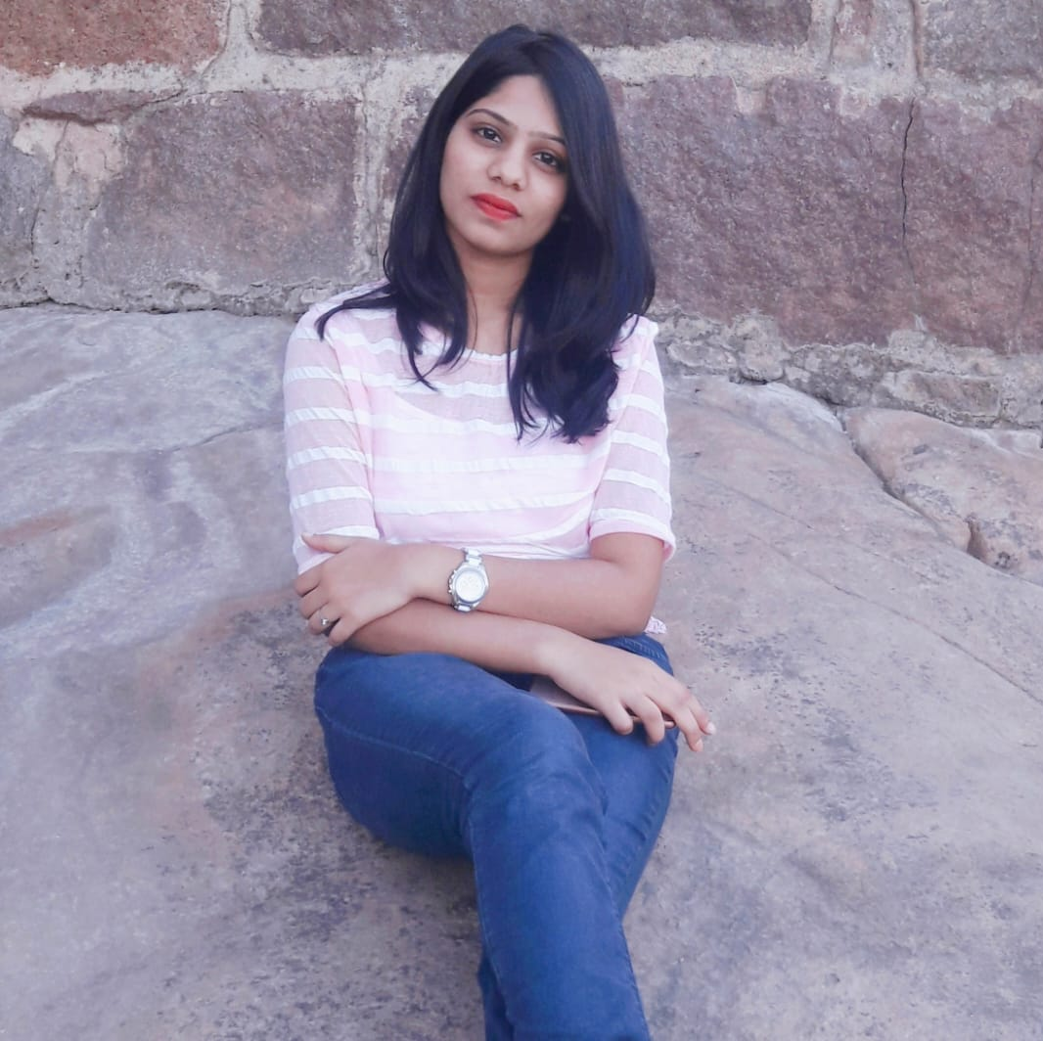


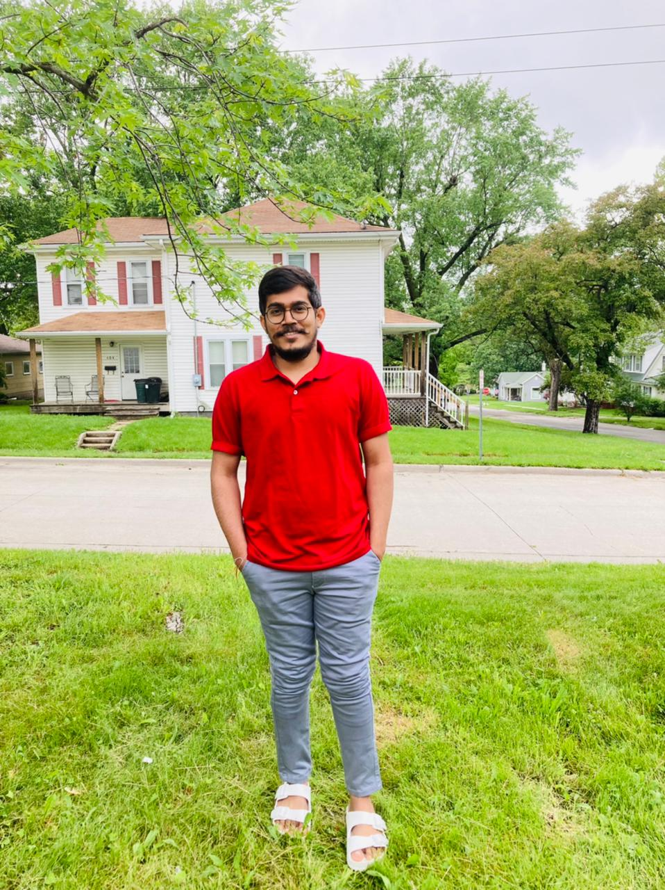
Team members
DR.CHANDRA MOULI
KOTTETI
SAJIDA MOHAMMAD
USHA PATI
Presented By Sajida
HARI KIRAN ALURI
KIRAN KUMAR GUNDAPUNENI

Slide 3
Table of Contents
Introduction
Technical Stack
Web Pages
Entities
ER – Diagram
Templates
Lessons Learnt
Future Implementations
Presented By Sajida

Slide 4
Introduction
Market place for Northwest Missouri
Students can purchase or sell products
CURD Operations can be performed on products
Presented By Sajida​

Slide 5




Technical Stack
Angular
Spring boot
Selenium
MySQL
Presented By Sajida

Slide 6
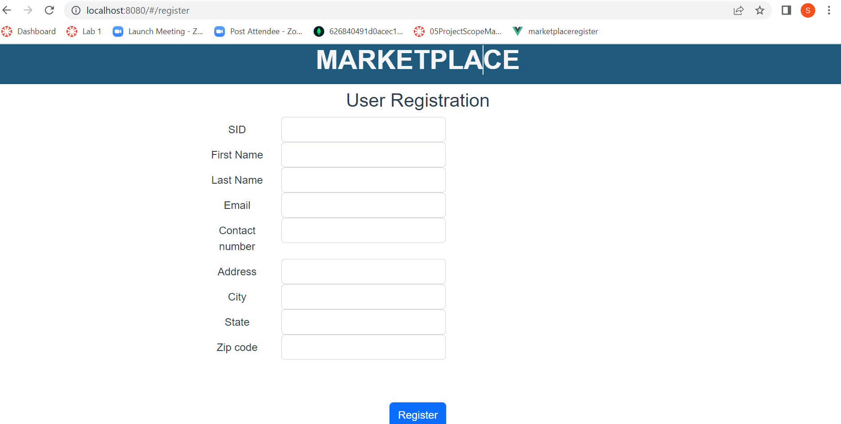
Registration Page
Registration
Login
Home
Chats
Sell
My Ads
Account
Fig 1.1 Student Registration Page
Presented By Sajida

Slide 7
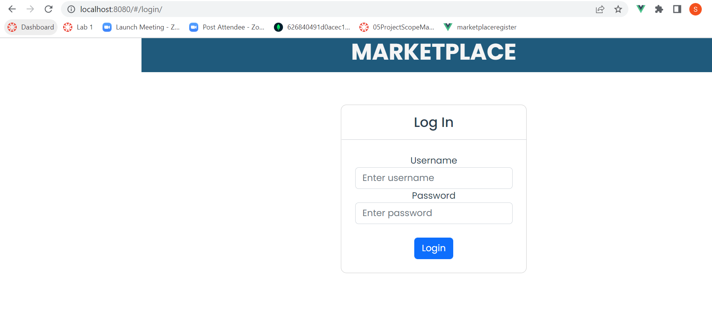
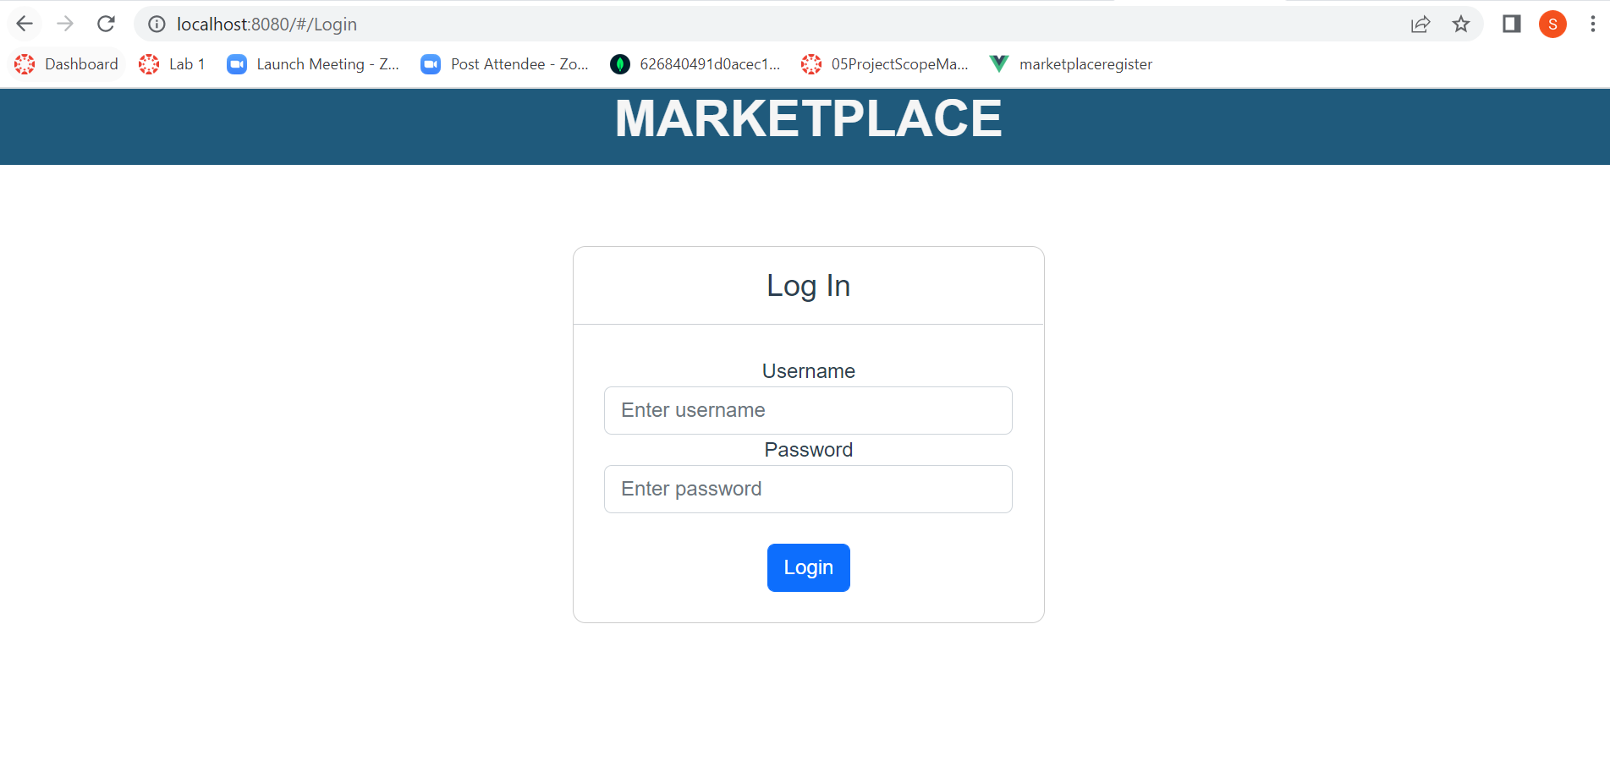
Login Page
Login Page
Fig 1.2 Student Login Page
Presented By Sajida
7

Slide 8
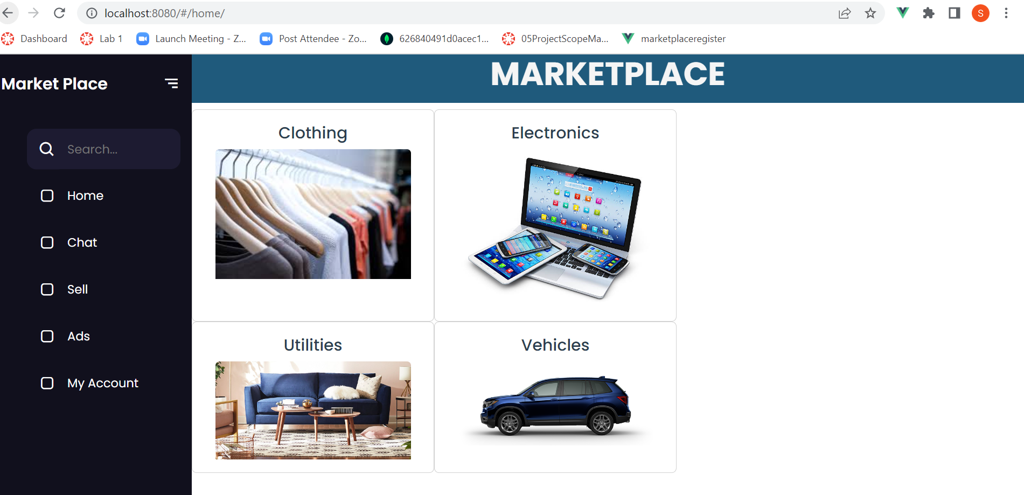
Home Page
Fig 1.3 Home Page
Presented By Sajida

Slide 9
Student Entity
Attributes:
SID
FirstName
LastName
Phone No
Email Id
Address
City
State
Zip
Presented by: Usha Pati

Slide 10
Products Entity
Attributes
productid
Product Name
Description
Category Id
SID
Price
Image
Qty Available
Seller Name
Seller Contact Info
Sold
Qty Sold
Presented by: Usha Pati

Slide 11
Category Entity
Attributes
Category id
name
Presented by: Usha Pati

Slide 12
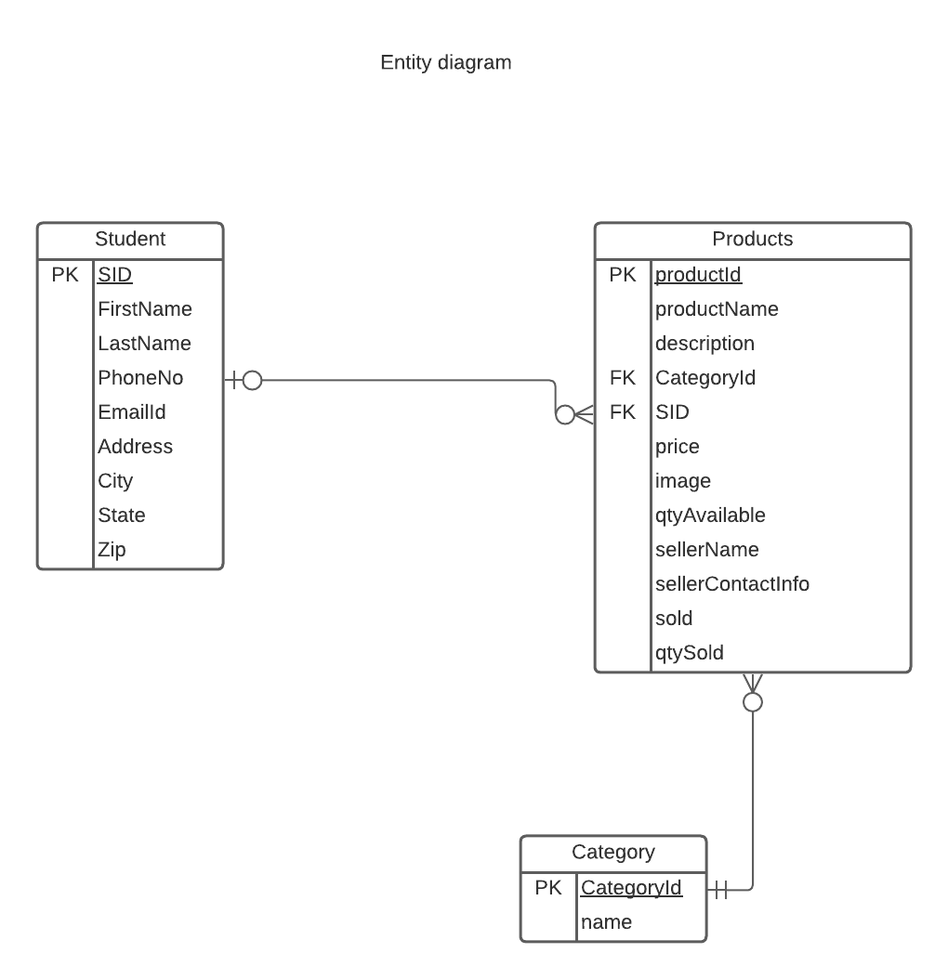
ER Diagram
Fig 2.1 Entity Relationship Diagram
Presented by: Usha Pati

Slide 13
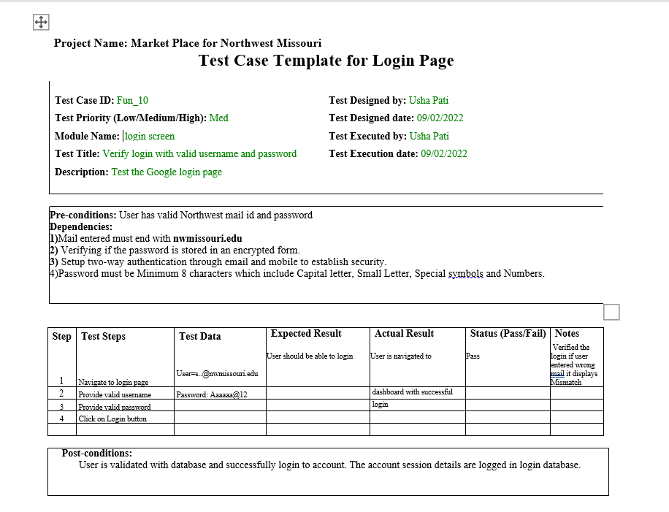
Template Creation for login Page
Fig 2.2 Test Template for login page
Presented by: Usha Pati

Slide 14
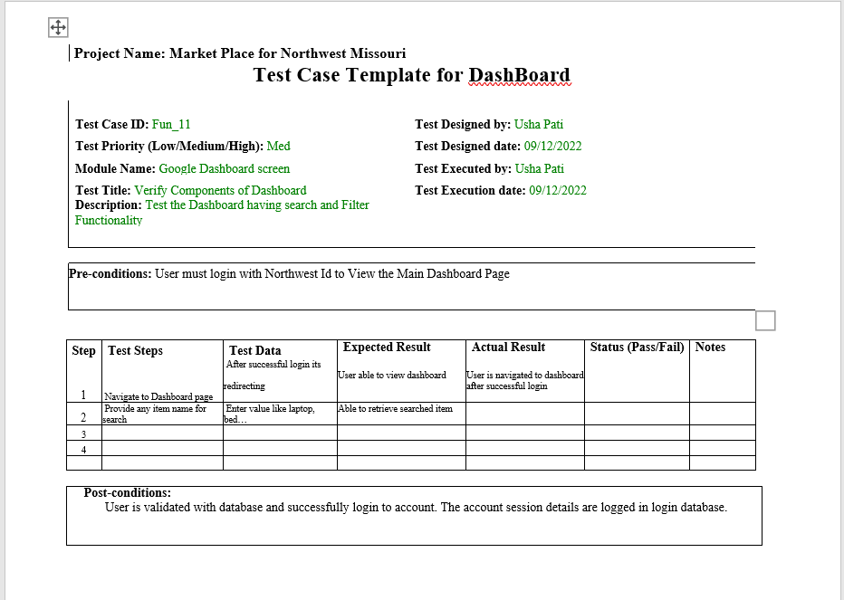
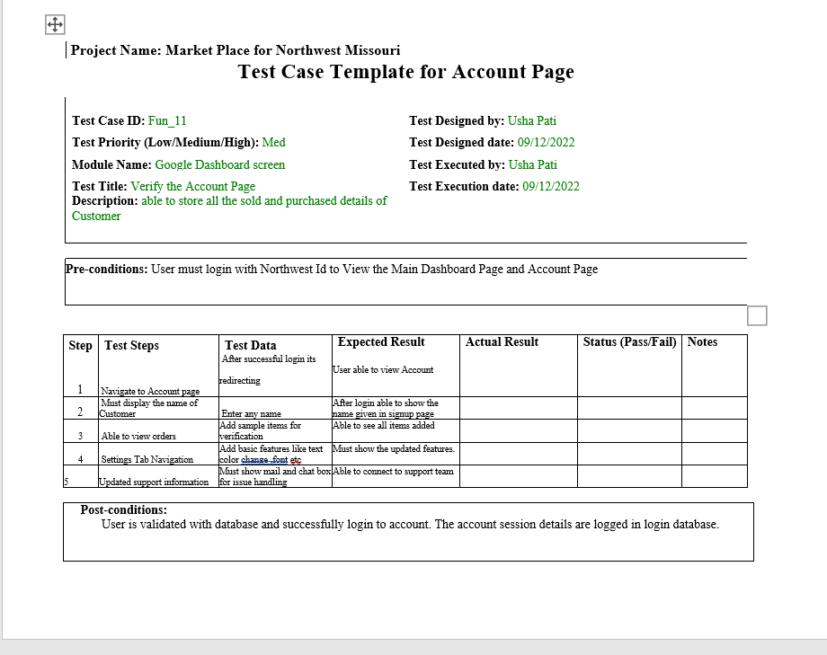
Template for Other UI pages
Fig 2.3 Test Template for Main Dashboard page
Fig 2.4 Test Template for user Account page
Presented by: Usha Pati

Slide 15
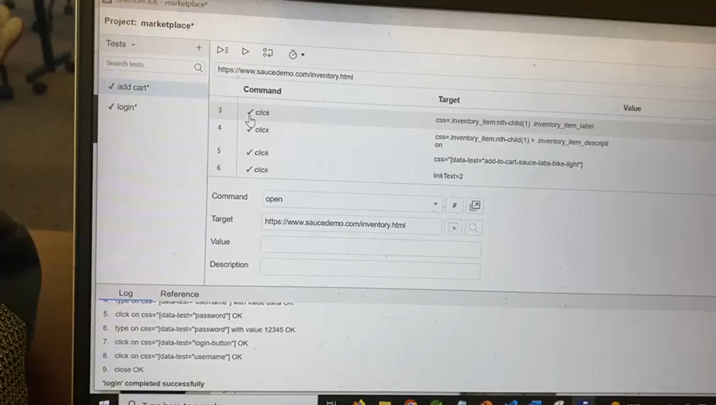
Fig 2.5 Add to Cart Functionality Log Recording
Presented by: Usha Pati

Slide 16
Angular
Angular is a development platform, built on TypeScript. As a platform, Angular includes:
A component-based framework for building scalable web applications
A collection of well-integrated libraries that cover a wide variety of features, including routing, forms management, client-server communication, and more
A suite of developer tools to help you develop, build, test, and update your code

Slide 17
Component
Components are the building blocks that compose an application.
A component includes a TypeScript class with a @Component() decorator,
an HTML template, and styles. The @Component() decorator specifies
the following Angular-specific information:
A CSS selector that defines how the component is used in a template.
HTML elements in your template that match this selector become instances of the component.
An HTML template that instructs Angular how to render the component
An optional set of CSS styles that define the appearance of the template's HTML elements

Slide 18
PRODUCT REGISTRATION API
In order to sell some product the Seller needs to enter some basic *properties of the project like name ,category , year of purchase , quantity available .
the data that is enter by the user will be stored in the database and should be displayed to the buyer

Slide 19
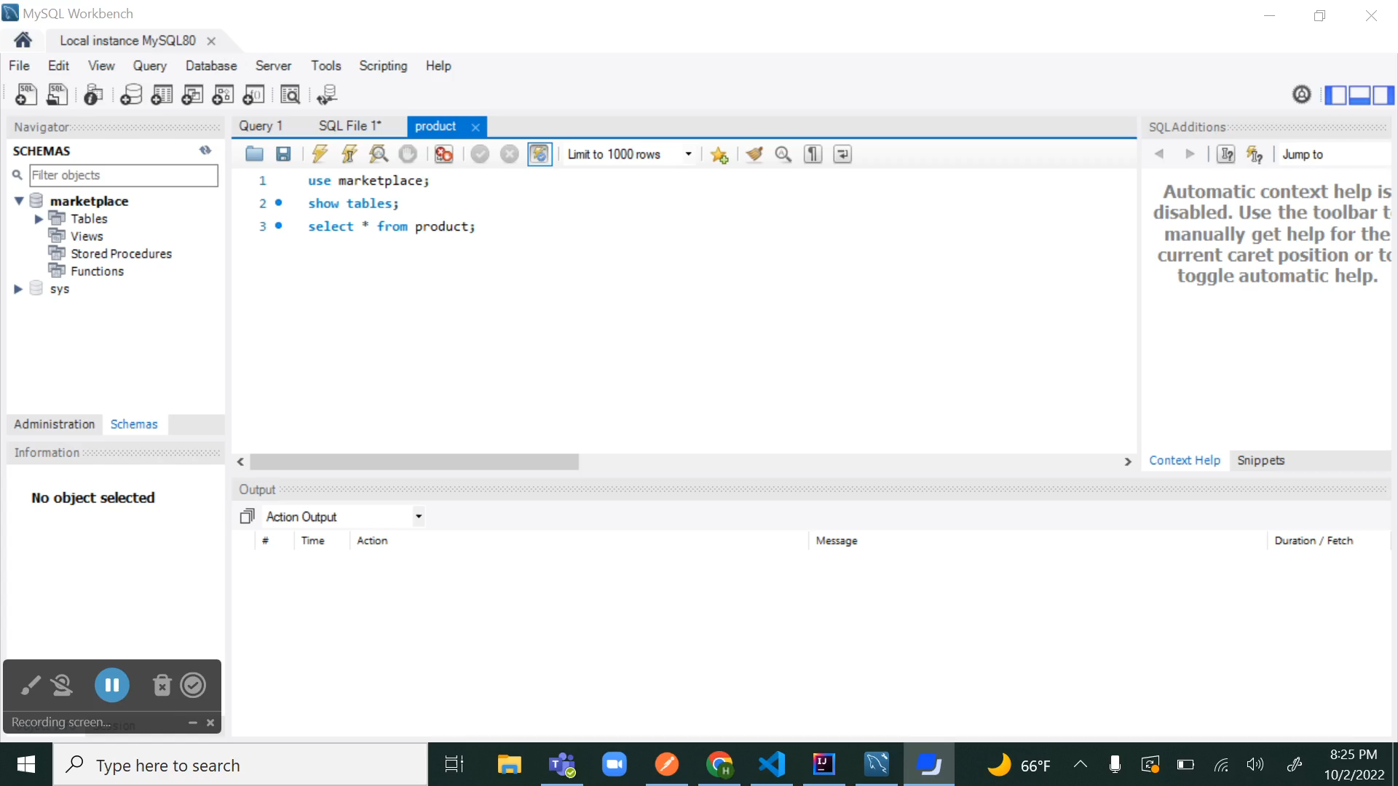

Slide 20
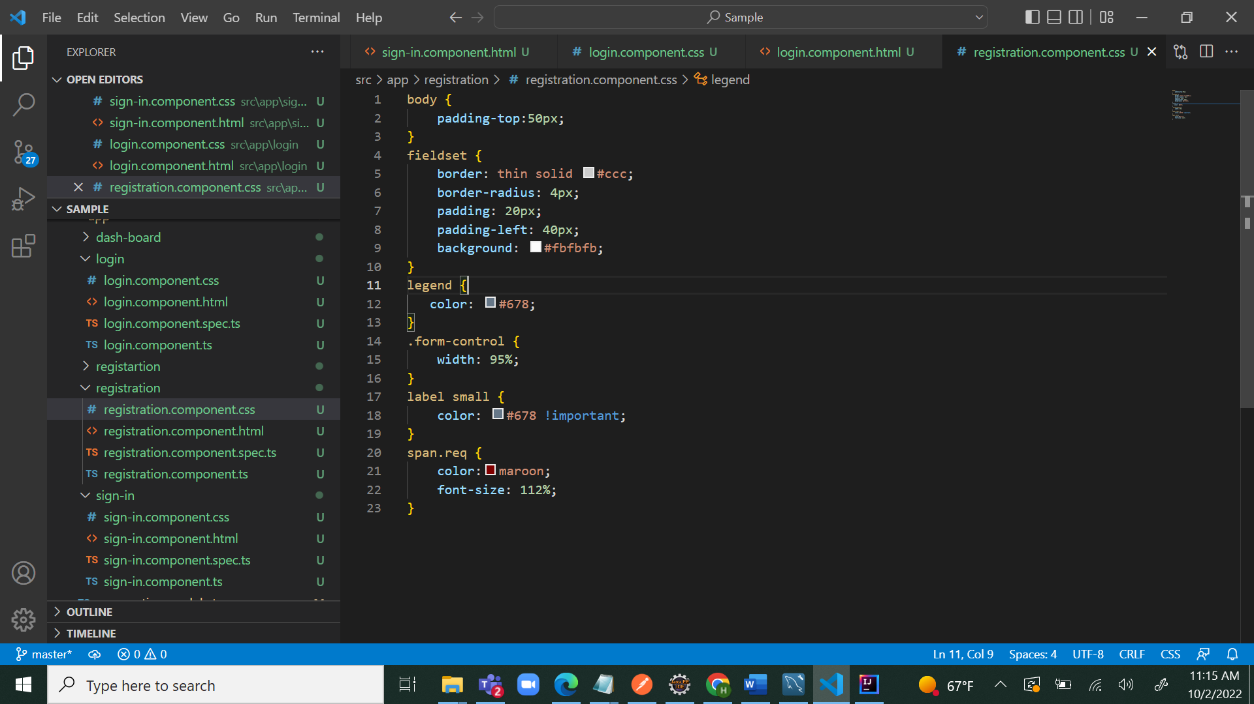
Fig-3.1 CSS file in angular

Slide 21
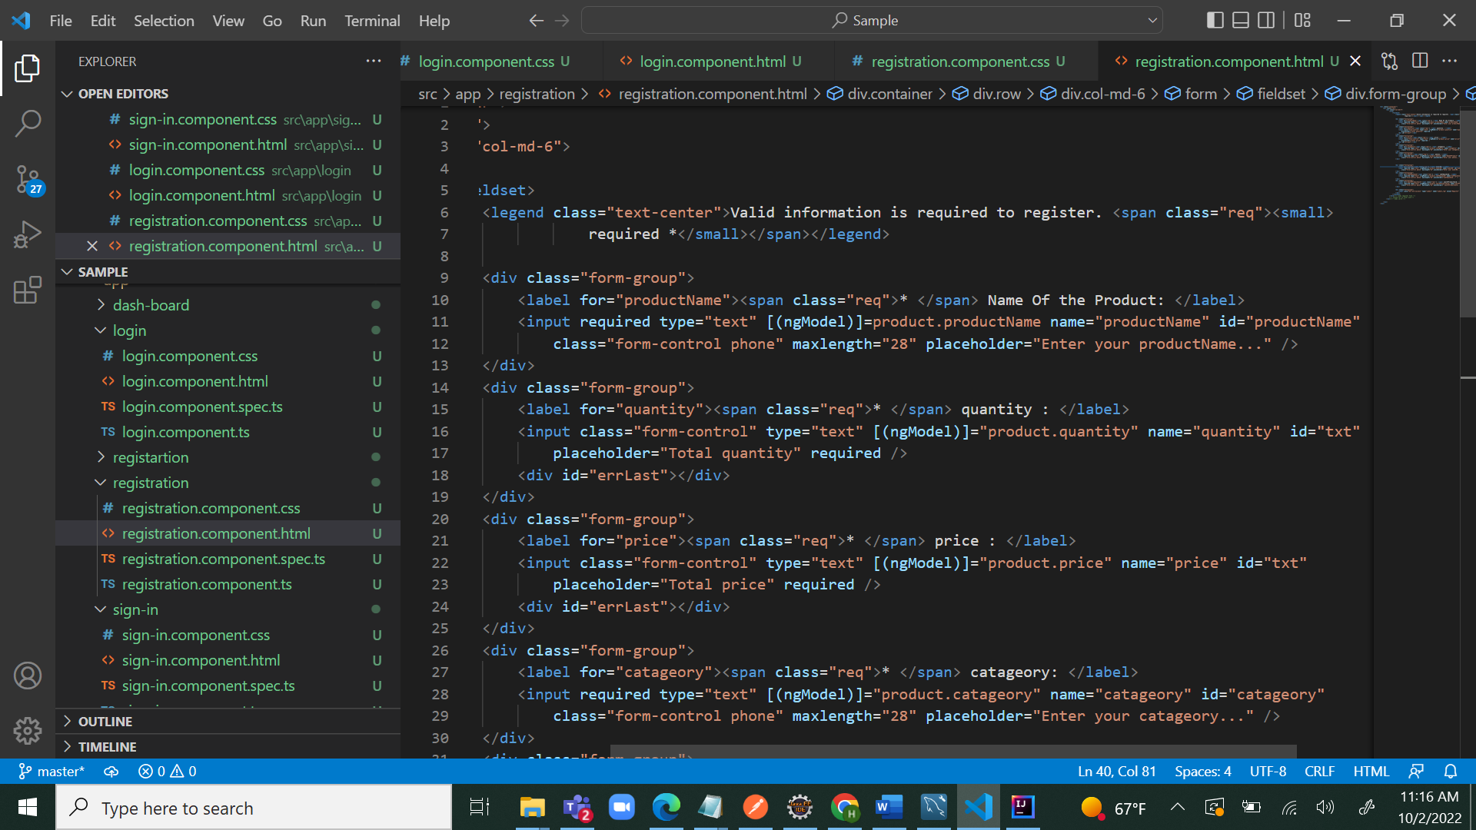
Fig-3.2 HTML file in angular

Slide 22
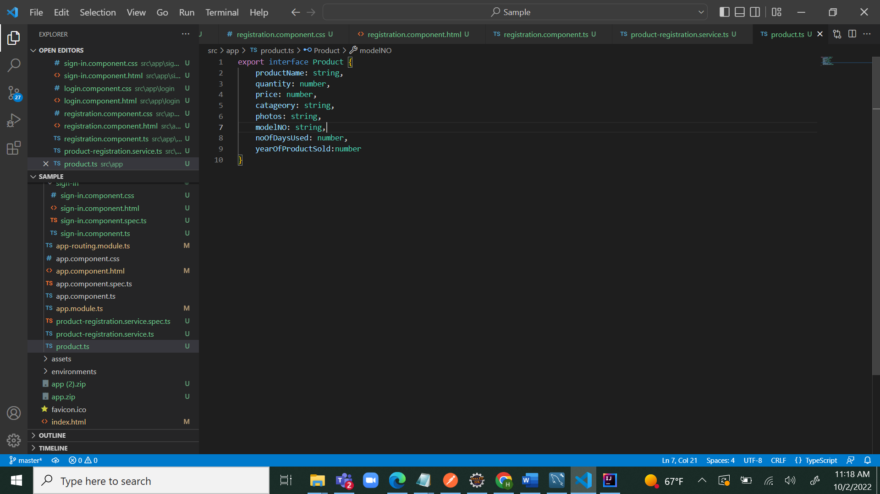
Fig-3.3 TS file In angular

Slide 23
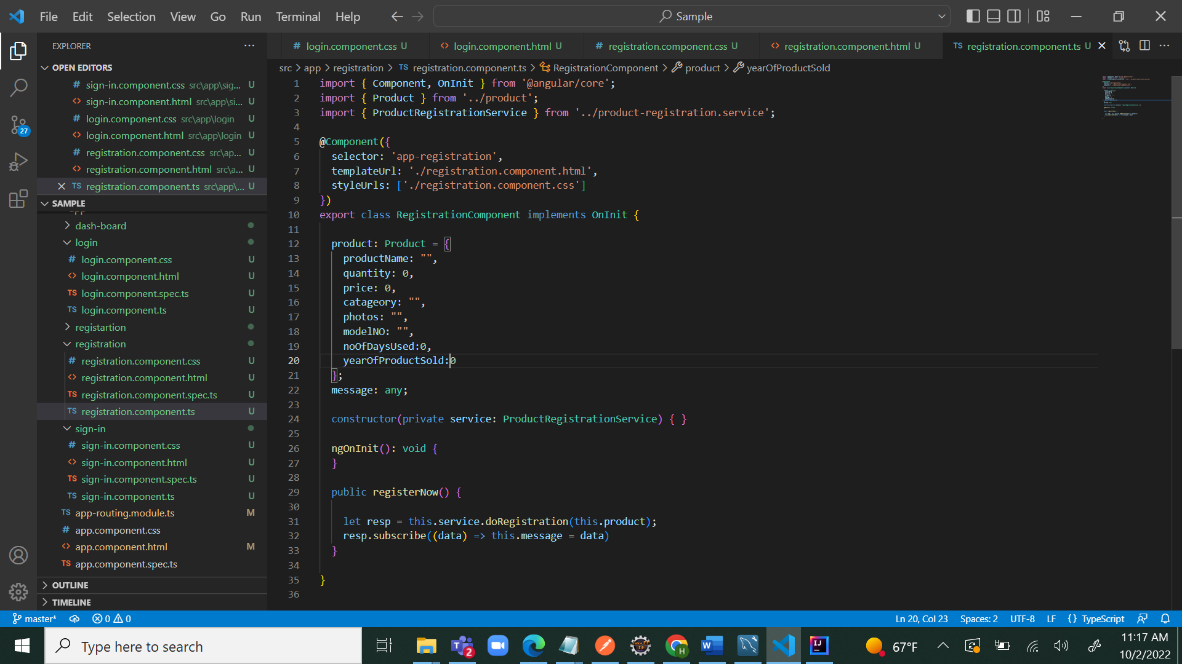
Fig-3.4 component .ts file in angular

Slide 24
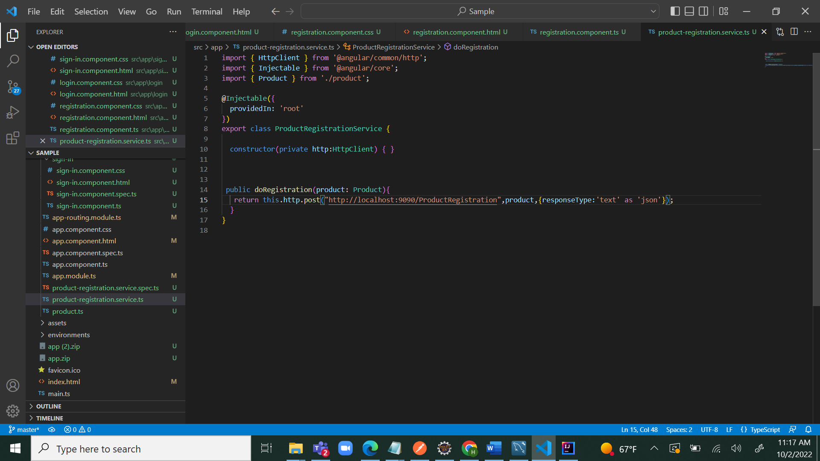
Fig-3.5 Service.Ts file in angular

Slide 25
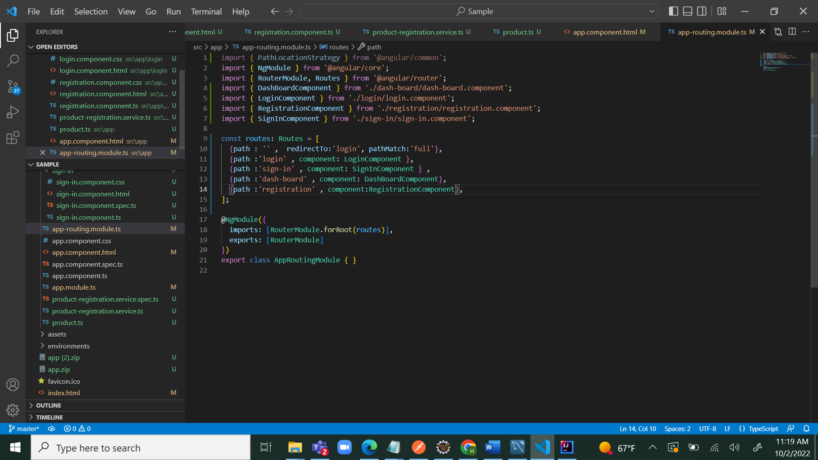
Fig-3.6 routing module in angular

Slide 26
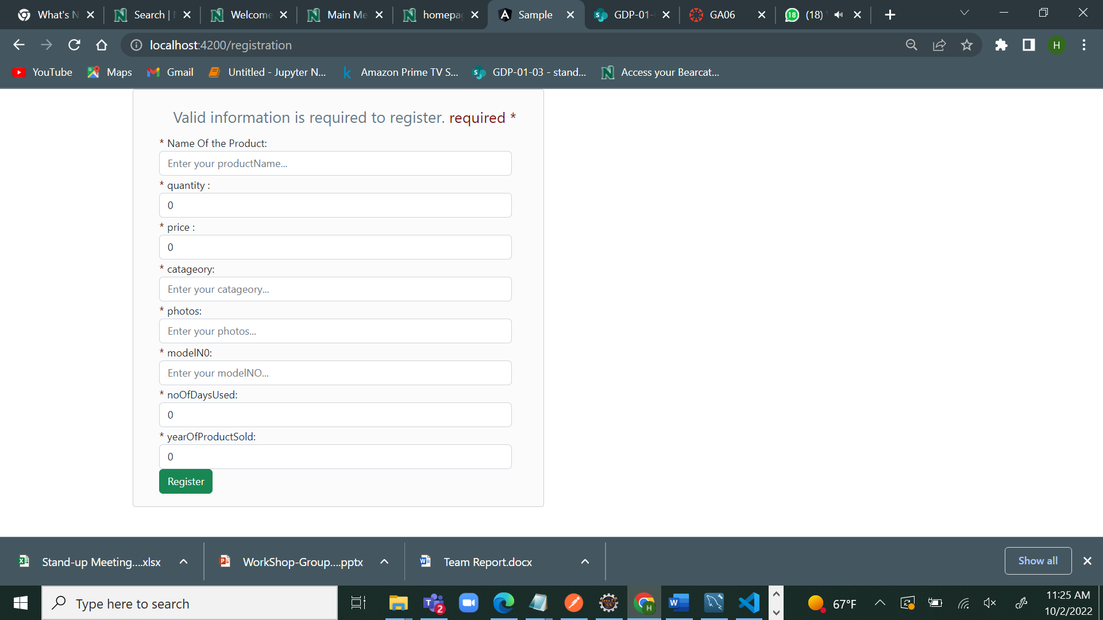
Fig-3.7 final outcome of the registration component

Slide 27
Spring Boot Development
1) In our application, we used spring boot-microservices to develop API services using RESTful webservices
2) It creates an API and allows to send a request and hit a response back to the method which we created
3) It mailny consists of a controller, entity and service, and repository packages.
4) Request from one service to another service can be called by controller
Presented By Kiran Kumar

Slide 28
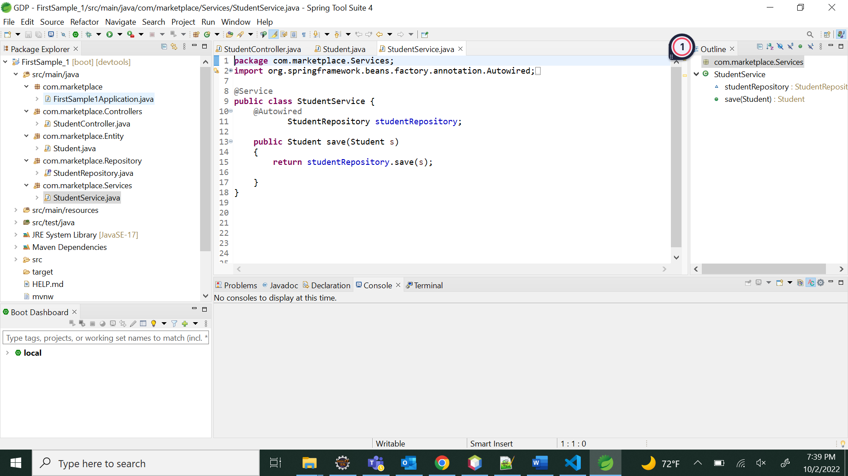

Slide 29
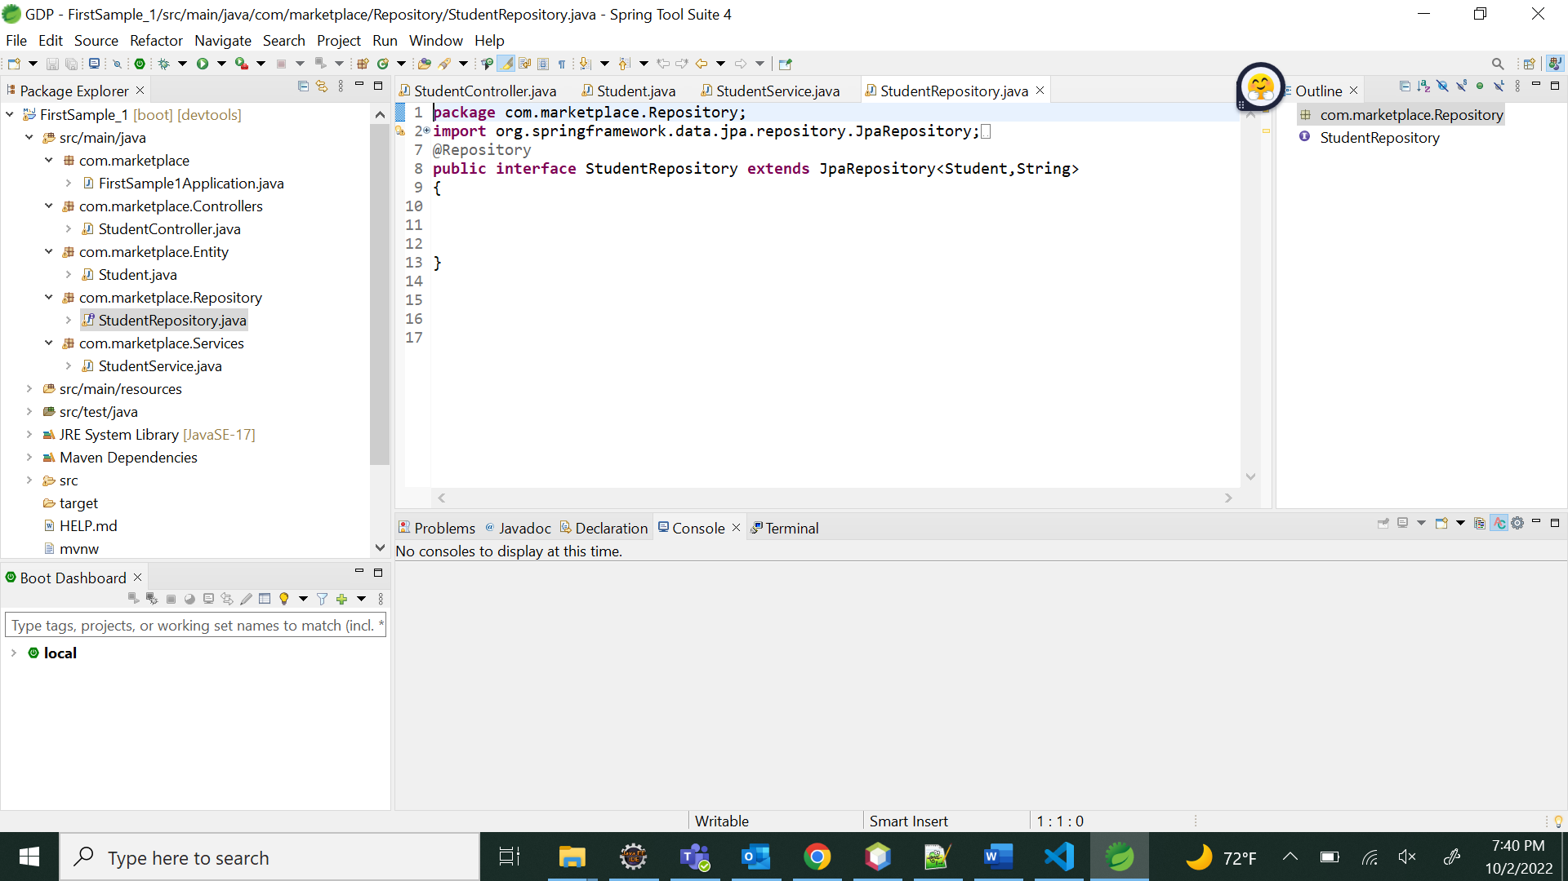

Slide 30
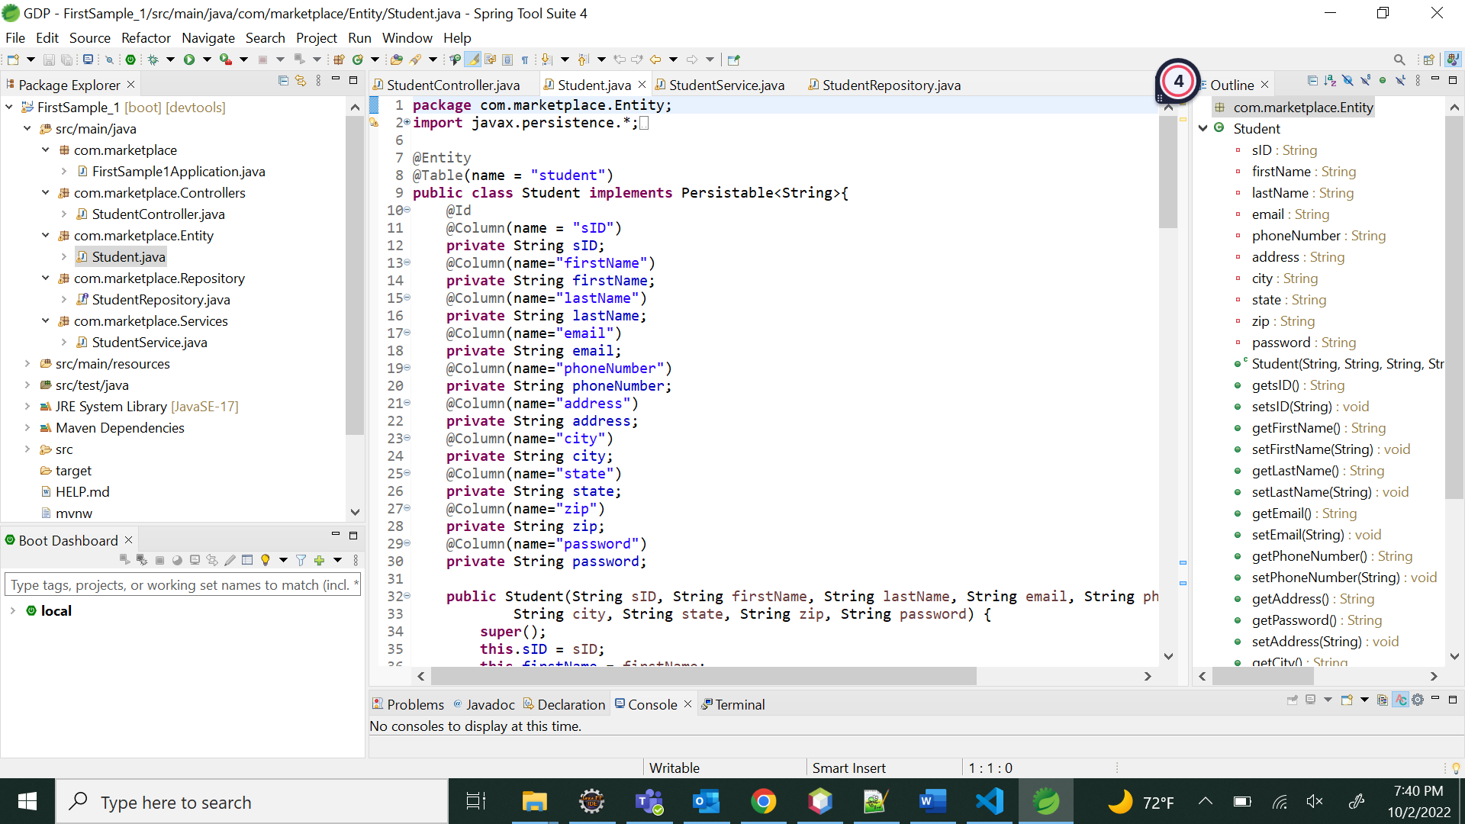

Slide 31
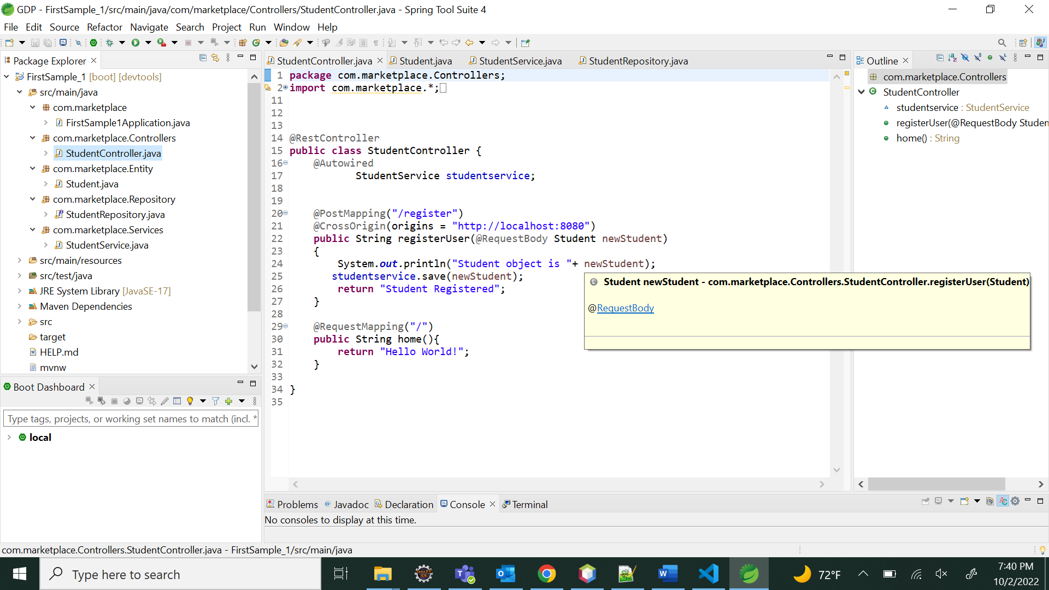

Slide 32
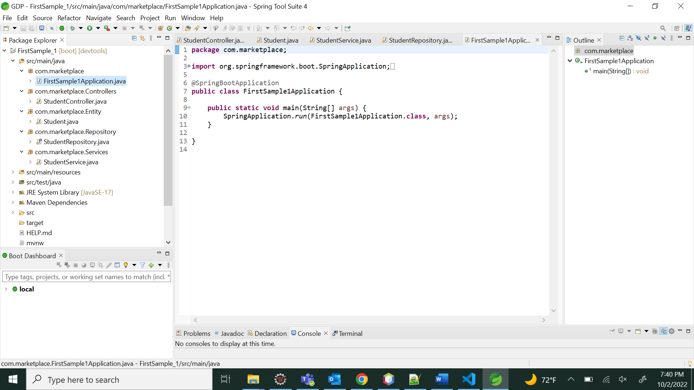

Slide 33
Lessons Learnt
During this project we learnt that entity schema is need to be finalized at the beginning of the project
And in working with spring boot, data layer and web layer should be very well integrated

Slide 34
Future implementations
To advertise app
To create a chat box
To create an Account API
To create My Ads API
To integrate all the API's successfully

Slide 35

THANK YOU

Slide 36
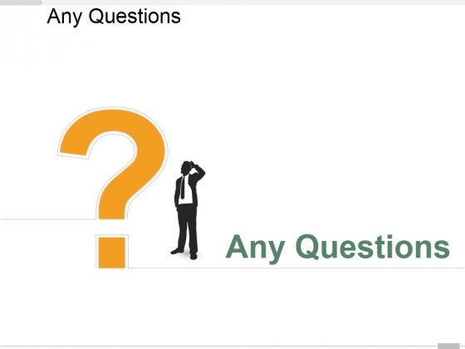

Slide 37
MARKET PLACE FOR NORTHWEST Buy and sell here
Section-03
Team-03
Dr. CHANDRA MOULI KOTTETI – Client/mentor
SAJIDA MOHAMMAD – Backend developer
USHA PATI – Tester/QA
HARIKIRAN ALURI – Team lead/Front-end developer
KIRAN KUMAR GUNDAPUNENI – Backend developer

